Slide 1
Myself Shah Hunain
I welcome you all to the introductory presentation of mine
I am really glad for your presence!

Slide 2
Table of content
Myself
Personal Information
Educational Background
Personal Experience
Skills
Hobbies and Interest
Academic Goals and Challenges
Favorite Movie
My pet
Conclusion

Slide 3
Personal information
Locality: Karachi, Pakistan
Age: 18
Education:
Matriculation from ‘ARMY PUBLIC SCHOOL-FAISAL’
Inter from ‘BAHRIA COLLEGE-KARSAZ’

Slide 4


Educational Background
SCHOOL
COLLEGE

Slide 5
Personal Experience
School:
The start was same as of all, I remember on the first day, I went crying all the way towards my class and interaction was un-sharable.
I met various friends some stayed with me till the very end and other left for new one.
I became the part of the council team from my very first class, I remember being called ‘Representator’
The journey was full of joy but the harsh thing always is a good bye especially to the one you loved.
College:
The start was like I wished to get rid of it as soon as possible, but understanding with teachers and friend zone made it a stage of joy.
I became the part of various societies with in the college, became the part of college council.
The best part was when I was called on the stage and got declared as topper from the boys wing.
The end to this part of life was contrary to the start and all went in tears.

Slide 6
skills
Interaction
Honesty
Respect
Mutual Understanding
Devotion
Believe in Yourself

Slide 7




HOBBIES and INTERESTS
Reading
Cricket
Writing
Music

Slide 8
Academic goals and challenges
Goals:
To become a successful person first.
To achieve everything, I have ever thought of.
To get expertise in my field of ‘Software Engineering’ and try my level best to excel.
Challenges:
I had to start up from scratch, as I had no idea of how programming is performed, but the background of my father(IT Manager) and brother(recently graduated from ‘FAST’ helped me a lot.
The very second challenge was of time management, in order to study and maintain a peaceful mind.

Slide 9

Favorite movie (SALVATION)
A non-fiction movie based upon facts.
The great example of never restrict yourself to something, you never know what else you can do, just give it a try.
Wonderful message of nothing is impossible, all it takes is continuous vigilance.

Slide 10
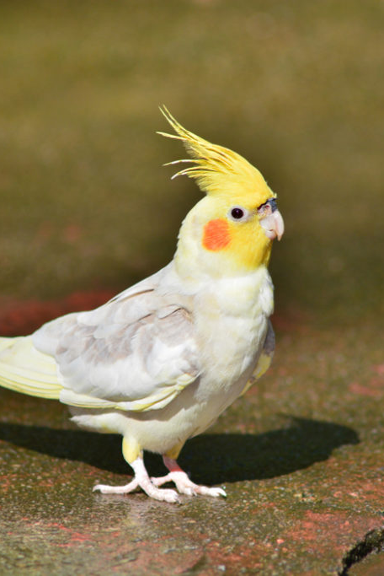
My pet (Australian parrot)
Facts:
Named ‘Riegal’
Truly a loving bird
Beautiful
Sincere
Sounds like pleasure

Slide 11
Conclusion
I will conclude this presentation with the quote that has inspired me a lot, that is:
“An aimless person is like a ship without a captain!”

Slide 12


